Slide 1
2025 2ND MECOP Mechanical Engineering Internship
By: Joseph Marsh
Team: Advanced Vehicle Systems
Internship: 03/31/2025 – 09/05/2025

Slide 2
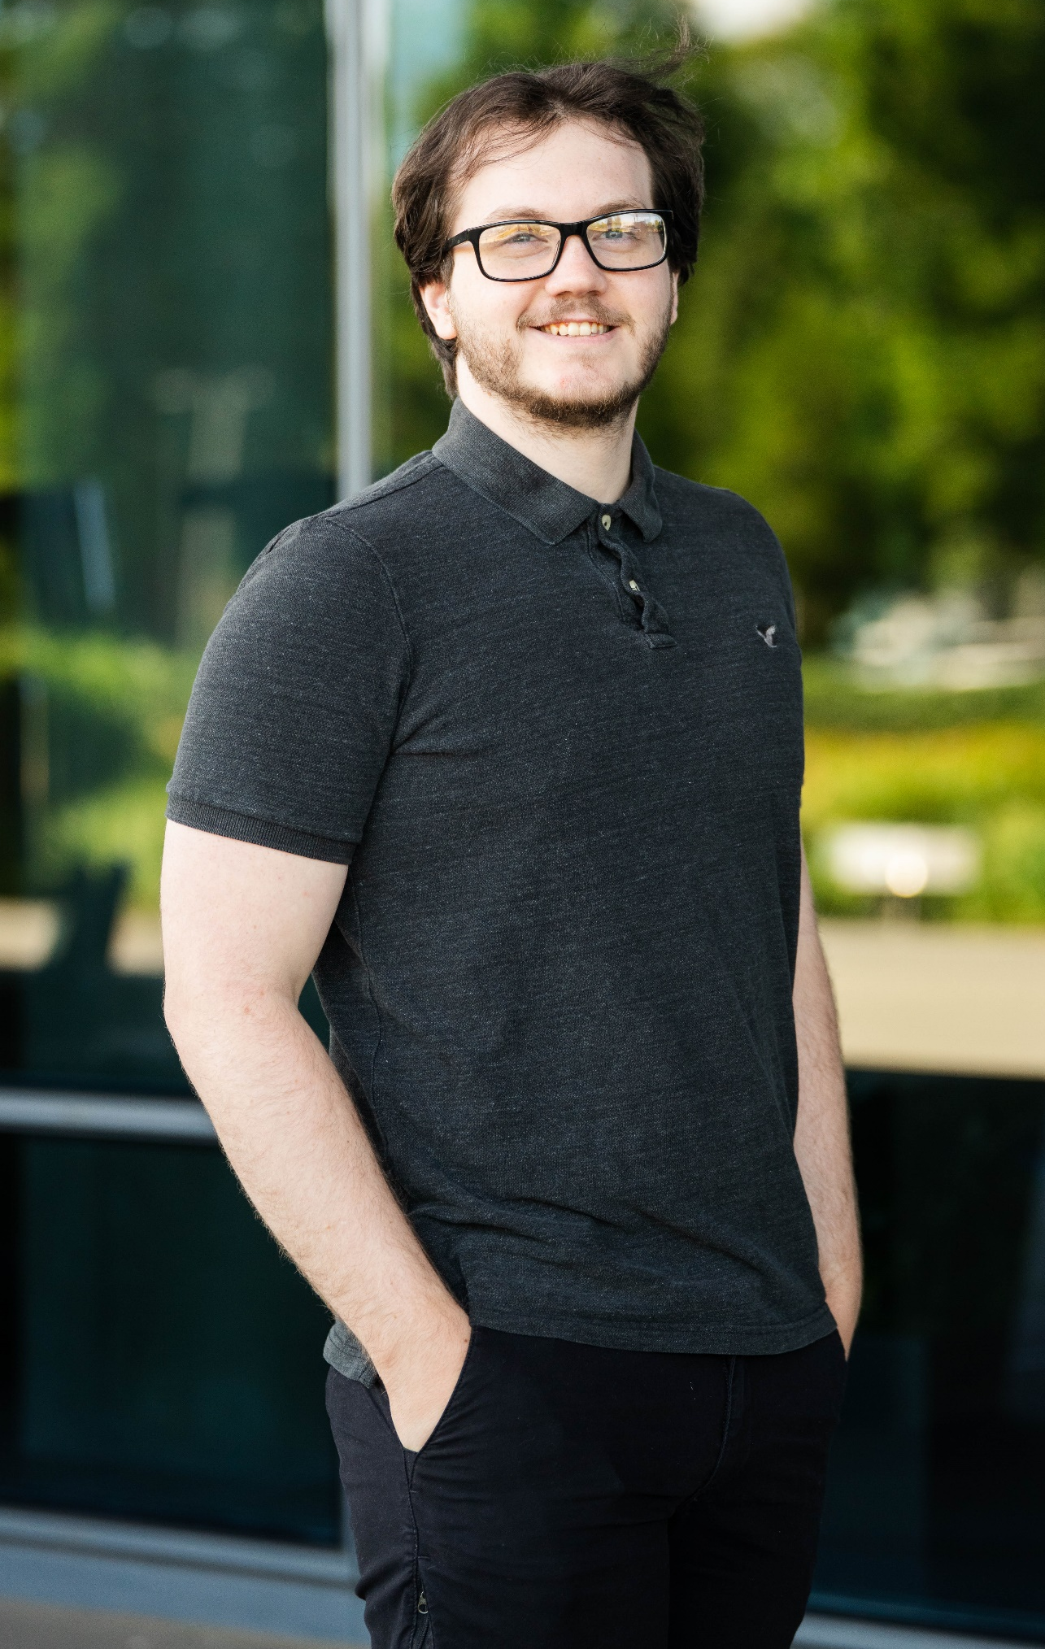

About Me
Education
Graduating Dec 2025 in mechanical engineering at Oregon State University
Advanced Engineering Director
Derek Rotz
Team Manager
Darek Villeneuve
Hobbies
Powerlifting
Bicycling
Watching TV with my wife
Mentor
Thomas Reed
Fun Fact
I got married June 22nd to my beautiful wife, Jadyn Marsh
Intern
Joseph Marsh

Slide 3
Project Portfolio – Internship Deliverables
Major Projects
Minor Projects
Aluminum Evaporative Cooling Tank
Low-cost replacement for plastic tank
Radiator Baffle Design
Reduced airflow recirculation to radiator
B-Sample Upfit Coolant Routing
Tight-clearance fuel tank coolant path design
Flowmeter Bracket Design
38mm & 50mm sizes
Pump Mounting Bracket
Complete CAD & drawings
Battery Cooling Surge Tank
Concept & fitment
Double-Ended Barbed Pipe Fitting
CAD model

Slide 4
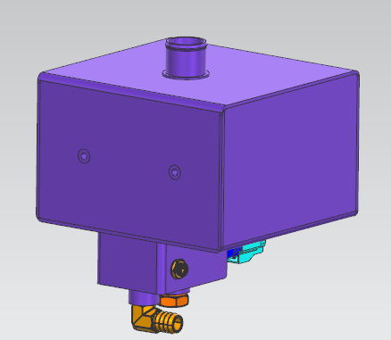
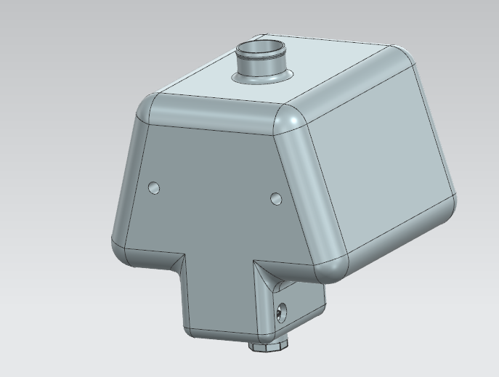
Major Project 1: Aluminum evaporative cooling tank (Final Demonstrator)
Project Scope
Replace previous plastic evaporative cooling tank with cheaper welded aluminum design
Aluminum Tank (New)
Plastic Tank (Old)
Department Interactions:
Chassis – Thomas Robinson aided with sensor placement and design

Slide 5
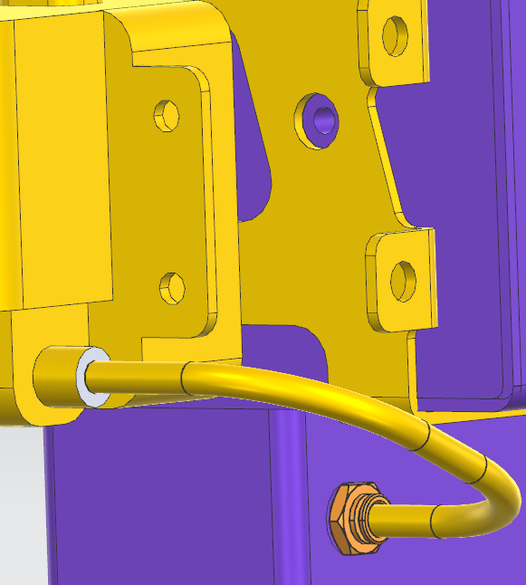
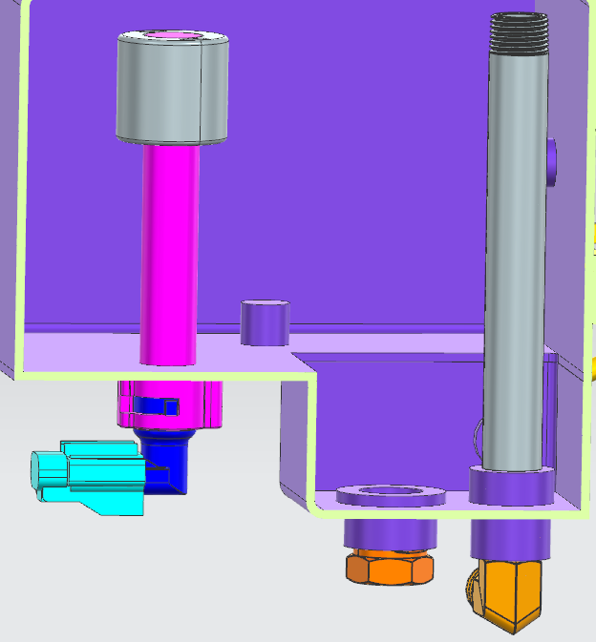
Key Project Requirements 1
Tank properly interfaces with necessary components
Subparts must be easily obtainable to reduce cost
$21 McMaster threaded pipe
Standard DTNA sensor
$20 McMaster elbow adapter
$20 McMaster plug

Slide 6
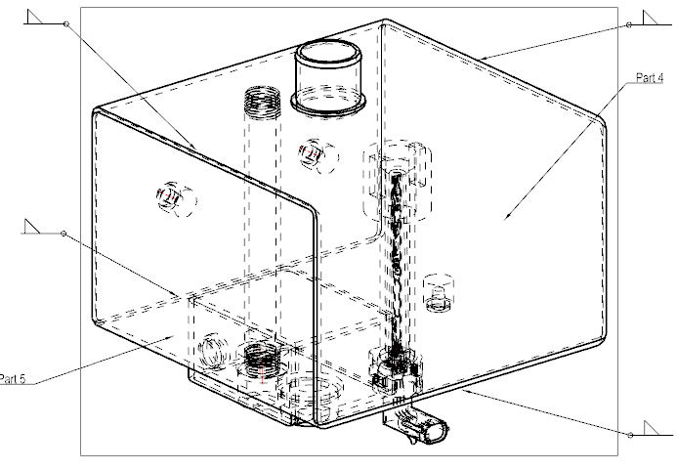
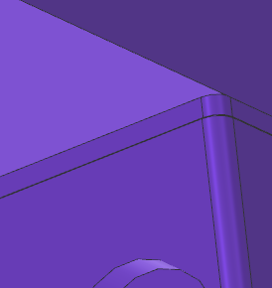
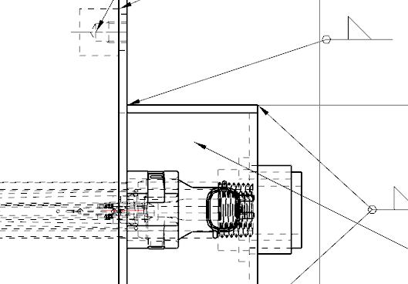
Key Project Requirements 2
Corresponding drawing and physical model weldments
Provide detailed drawings to supplier for all parts, including assembly. All welds must be called out to ensure water-tight tank.

Slide 7
Challenges
Key Learnings and Takeaways
First experience with NX at DTNA
Fitting design into overall truck
Reaching out for help initially felt intimidating
No direct path for many parts so we had to think of a solution with premade parts
Importing vendor parts into NX
Interfacing parts within a single assembly
GD&T
Limitations and uses of welded aluminum

Slide 8
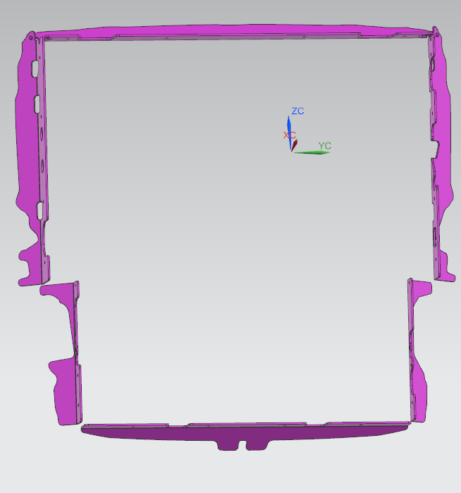
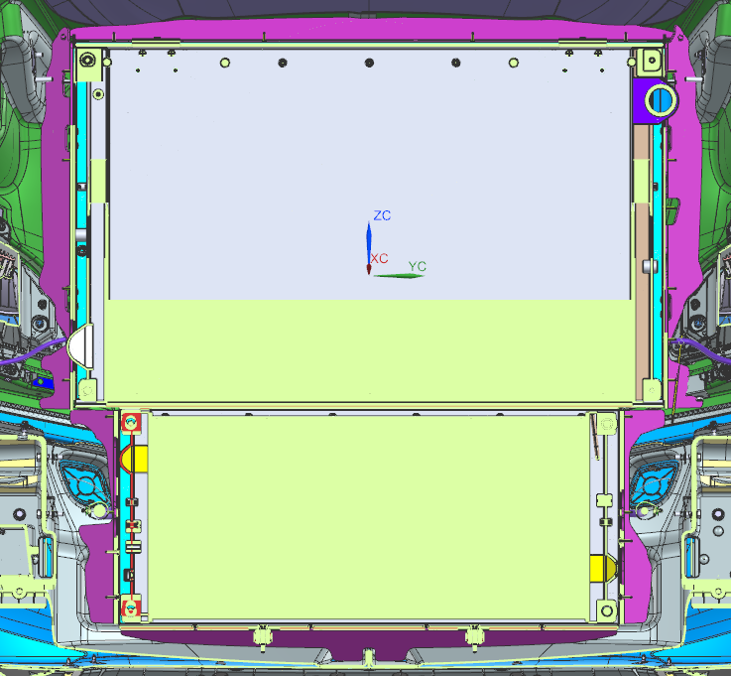
Major Project 2: Radiator Baffles (Final Demonstrator)
Isolated Baffles
Project Scope
Needed 6 baffles to prevent recirculating airflow to radiator
Design in Context
Interacting Departments/Companies:
Mahle – Updated baffle designs concurrent with radiator developments
Chassis – Airflow knowledge (Ovidiu Salagean) helped define baffle clearance

Slide 9
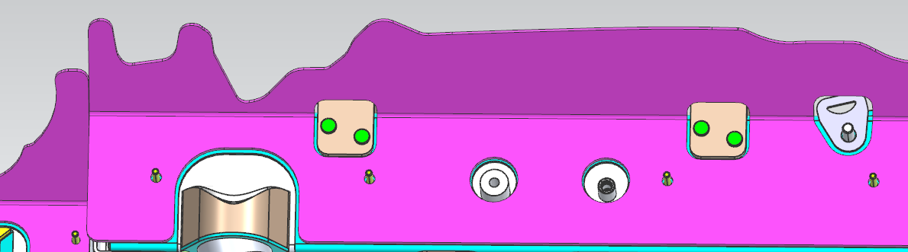
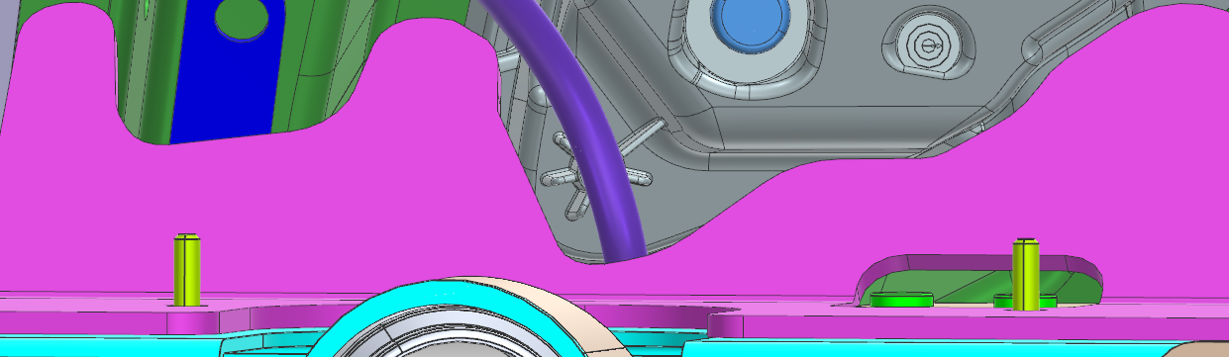
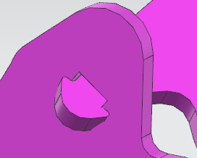
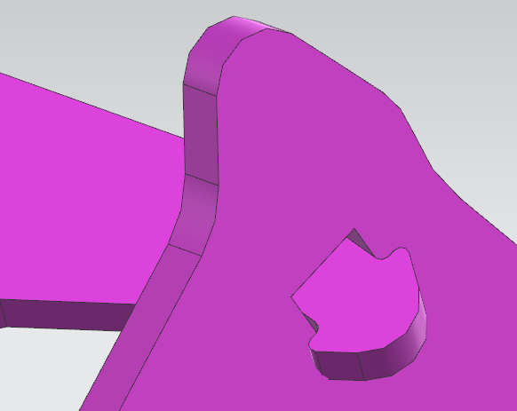
Key Project Requirements
Baffles attach direct to radiator and cutouts for all intersecting components
Consistent 6mm between hood components and baffles
Simple locking feature to join upper baffles

Slide 10
Challenges
Key Learnings and Takeaways
Given one week to fully design baffles
Updating baffles with new radiator designs proved challenging
NX Learning
Complex part integration
Intersection curves (NX tool)
Discuss all changes when synchronously developing a product

Slide 11
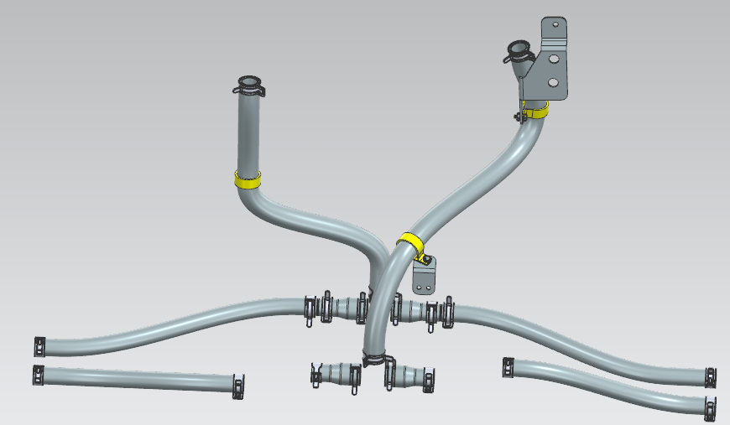
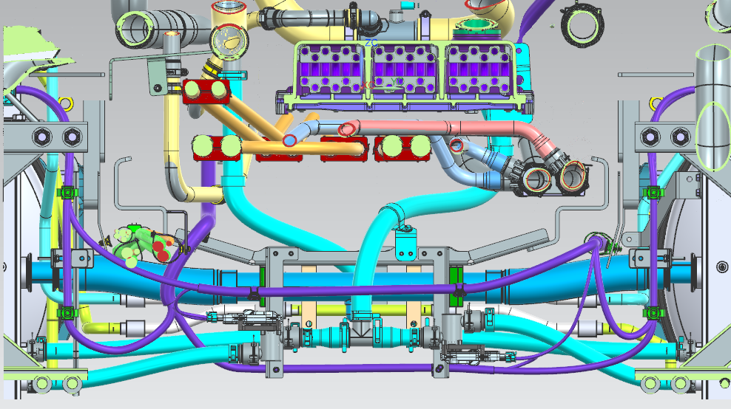
Major Project 3: B-Sample Upfit Coolant Routing Design
Project Scope
Create new coolant lines going to and from liquid hydrogen fuel tanks
Isolated Coolant Routing
Contextualized Coolant Routing
Department Interactions
DTICI – Updated designs based on DTICI input (Vasanth Rajagunasekaran)

Slide 12


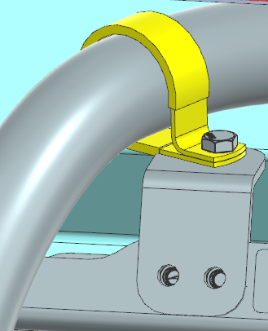
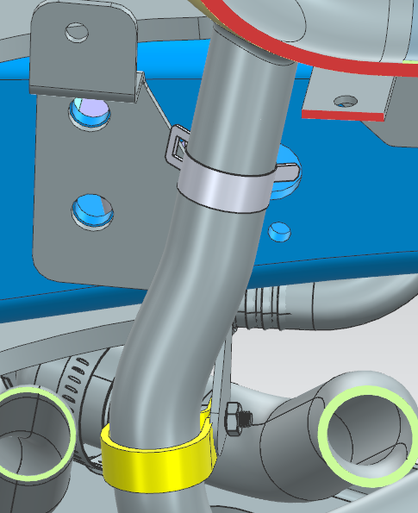
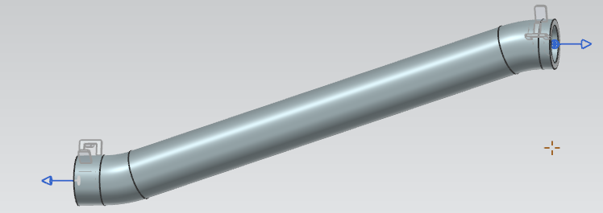

Key Project Requirements
CAD routing accurately reflects real-world tube bending and geometry
Model and include all relevant clipping and bracketry

Slide 13
Challenges
Key Learnings and Takeaways
Extremely tight clearances made routing very difficult
Bend radius limited routing paths substantially
Initial designs scrapped due to changing coolant layout to more efficient design
Siemens NX routing application
When working with people across the world, consistent communication is crucial
Whenever possible, have physical products on hand to mimic designs

Slide 14
Positives
Improvements
Challenging and engaging work
Experienced varying disciplines of ME design (Routing, sheet metal, solid modelling etc.)
Opportunity to work on a project that will eventually propel the world forward
Felt like a part of the team working as an entry-level full-time engineer
Great work life balance
IT Onboarding – Many interns had trouble onboarding, causing 2-3 weeks of missed opportunities
Intern Cross-Team Experience – Teams work together to give an intern a 1–2-week mini project on a new team, giving a variety of experiences to interns

Slide 15
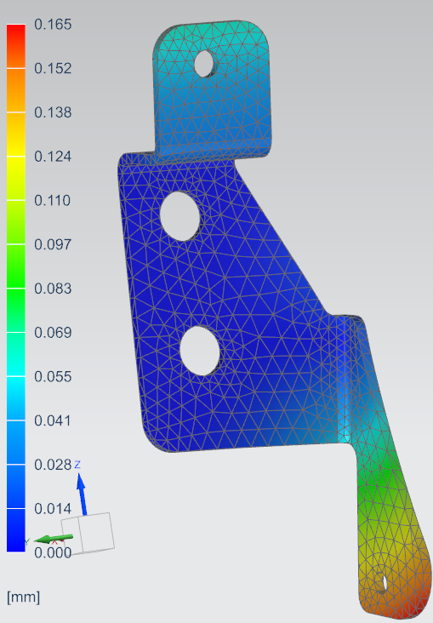
Key Internship Improvements and Learnings
Non-Software/Social Learning
Everyone has a different expertise… ask around!
Review designs with multiple people
Make sure project requirements are clear up front
Learn how each person communicates
Software/Technical Improvements
Siemens NX Applications
Solid Modelling
Sheet Metal Design
Tubing/Routing
Drafting (GD&T)
Advanced Simulation (FEA)

Slide 16
Thank You for a wonderful experience and a meaningful internship

